Slide 1
Advanced OOP
COMP1011

Slide 2
Agenda
Introductions
Syllabus and course outline
Overview of course tools
What are features of human resource systems
Building class diagrams
Converting class diagrams into code

Slide 3

Introductions
At your table:
Introduce yourself
Show on google maps where you are from
Name 1 thing you really want to learn in this course
Share 1 thing that people probably do not know about you
Be prepared to introduce everyone at your table

Slide 4
A little about me
Notes:
Most of my career was spent developing large IT projects in the mobile communications space. Mostly with Rogers, but also did work with Bell, Bell West, Telus, DND and Lyris.
Most of the businesses that I have worked for/with are medium to large scale organizations. Their standards were very high and the expecations of their employees was very high. But as I result of working hard, I got to do great things like travel the world (Sweden, Germany, England, Australia, San Fransisco, Dallas, San Jose, Vancouver, Halifax, Calgary, and many more great places).
I like to do boating, skiing, golfing, I experiment with amateur photography, spending a lot of time with my family.
My thought process is that to be successful, you will all need to know how to learn. How to push yourself and how to break through barriers.
I do not accept excuses. If you want to be successful in life, you have to leave excuses behind. I believe in negotiating the terms up front, but then holding people and organizations accountable to the terms. How does that translate in the context of schools?
-I will work with you on agreeing for due dates that are realistic for assignments
-I will provide you with detailed rubrics defining how the marks will be awarded
-I will support your learning efforts (proportionally to how hard you work)

Slide 5


Slide 6
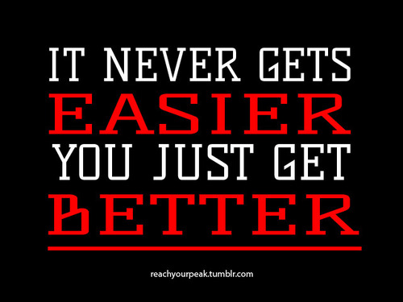

Slide 7
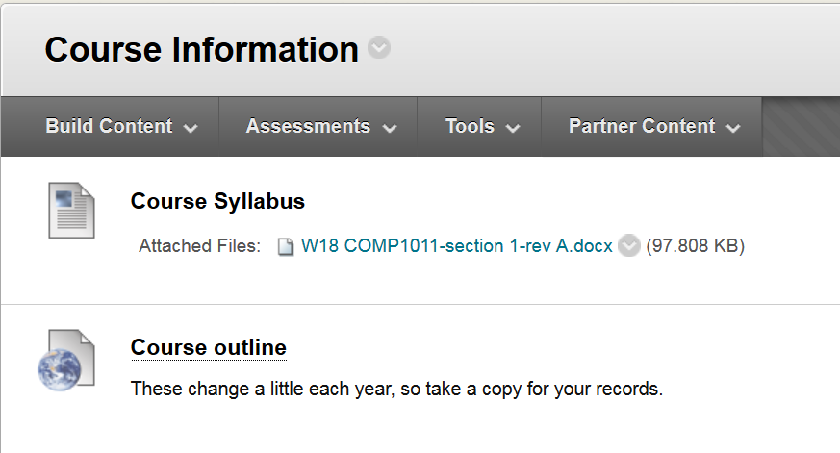
Course Outline and Syllabus

Slide 8
Course tools
IDE of your choice (I will use Netbeans)
MySQL Server and Workbench
Scene Builder (for use with JavaFX)
Helpful knowledge bases
Text Book
Videos
Google (yes, you must perform research in this course!)

Slide 9

Pre-assessment

Slide 10
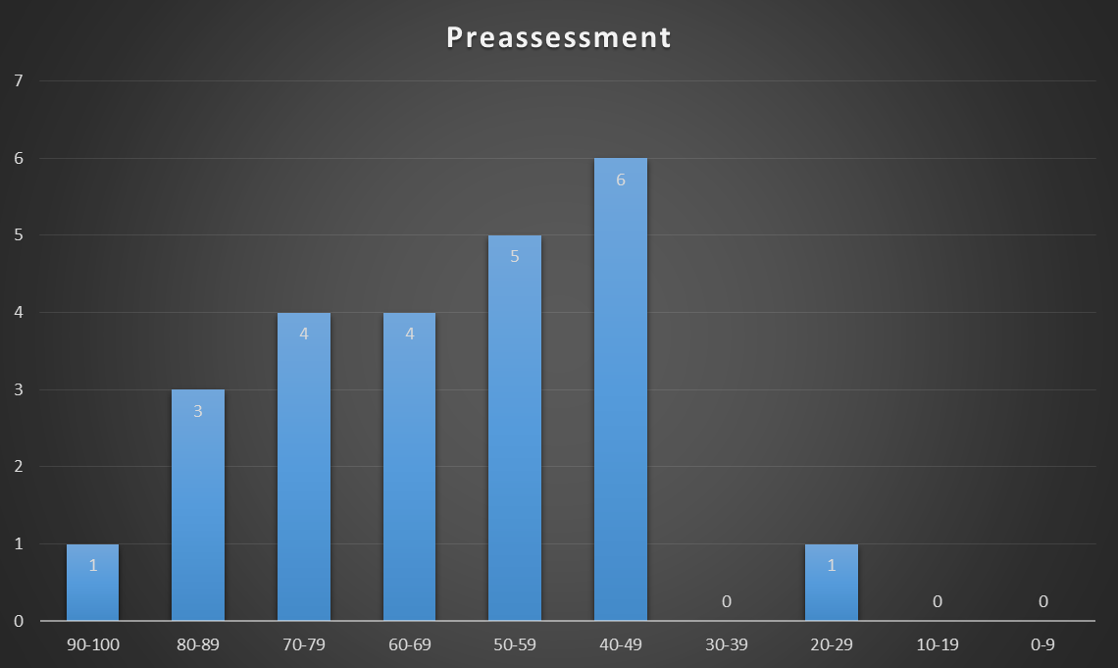

Slide 11
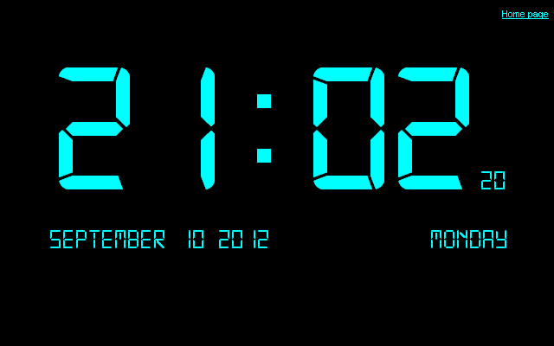
Classes and Objects
Class
Constructors
Overloaded constructors
Validating inputs
Exceptions
Public, Protected, Private

Slide 12
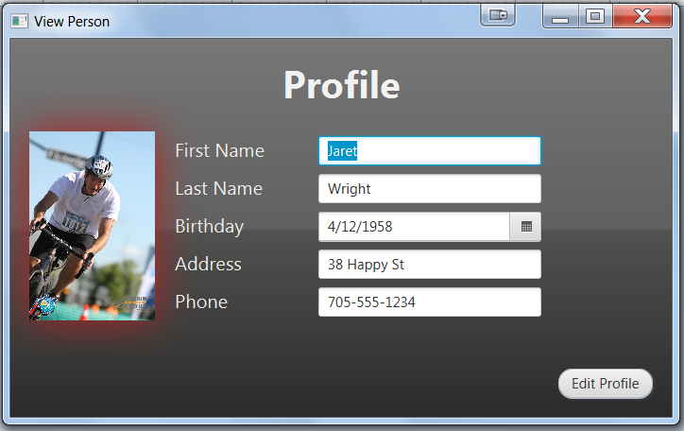
Assignment 1

Slide 13
Volunteer tracking application
Scenario:
A small charity works with hundreds of volunteers. The administrators currently handle all of their names, schedule and logged hours on paper in a binder.
Our goal this semester:
Build an application in Java that can store volunteer information in a database.

Slide 14

What classes will we need?
In your groups, document what “things/objects” we would need to create in the system. For example, we have the concept of people and their contact information.
What about classes for administrators vs volunteers?

Slide 15
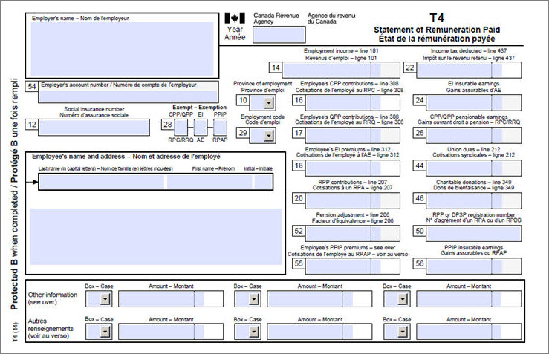


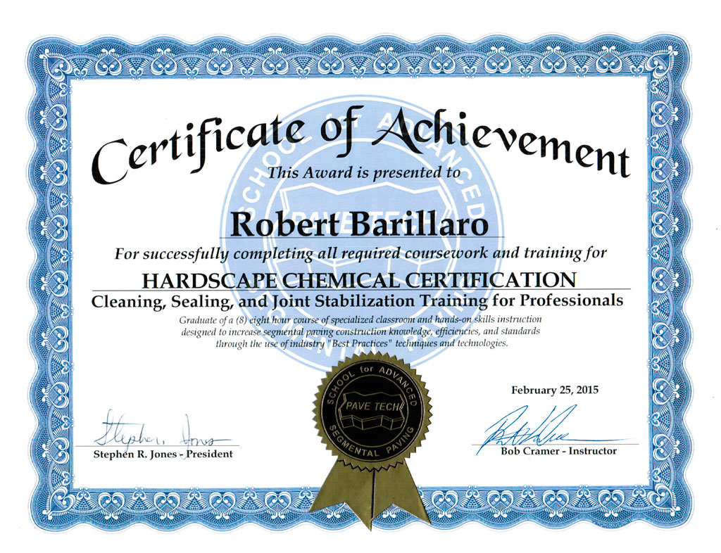

Building class diagram

Slide 16
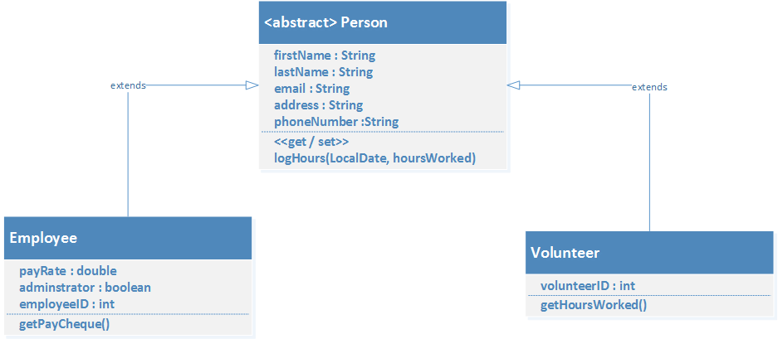
Convert a class diagram to a class

